Slide 1
Stoplight with LED Counter
Amadora, Angelo John
Aquino, Kurt Neil
Choy, Matthew Seaver
Ramos, Luis Angelo
S18

Slide 2
I. Introduction
Digital Designing is the organization and logic design of digital systems. This course presents a structured design philosophy, emphasizing hardwired and microprogrammed control, boolean algebra, hardware building blocks, circuit synthesis, as well as microprogramming.
One characteristic of digital systems is their ability to represent and manipulate discrete elements of information. Any set that is restricted to a finite number of elements contains discrete information. This is what coins the term “Logic Design”.

Slide 3
Abstract
For our group’s case, we decided to implement one of the more common applications of digital systems, in traffic control, to be more specific, a stoplight system with an LED counter.
As most traffic light systems are being controlled with built-in processors, so that they may be remotely operated from a station or whatnot, our own implementation will only make use of simple logic gates and binary manipulation. Through the use of data analysis, logic representation, and basic circuitry, our group aims to apply the lessons taught in this course and represent it by using the digital system that we wish to simulate.

Slide 4
Objective
To further explain the desired output of our group’s project, we wish to implement a single traffic light system with a fully working counter. The seven segment LED display will count down from nine to four (9-4) with the green LED lit, from three to zero (3-0) with yellow, and finally, from five to zero (5-0) with red. After a single cycle (16 counts), our system will then loop again and restart the count.

Slide 5
II. Methodology
Before any actual implementation should be done for any digital system, one should first discuss as to why you need the system.
Next is how you wish to present the outputs, which was discussed in this paper’s objective.
Finally how will you implement the circuit system itself.

Slide 6
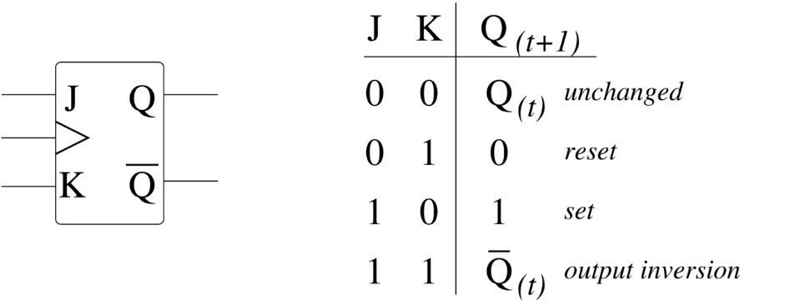
Discussion of Parts
Function Generator
Function generators are important for an electrical circuit. It produces different kinds of signals, and it can be used as a signal source.
JK Flip Flop
In the field of electronics, the flip-flop or so called a “latch” is a kind of circuit that can be used to store state information. The flip-flop is also a bistable multivibrator, meaning that it is able to deliver the information from one state to the other. Usually, people implement a multivibrator whenever the circuit requires a timed interval. The flip-flop is mainly used as data storage elements for the circuit.

Slide 7
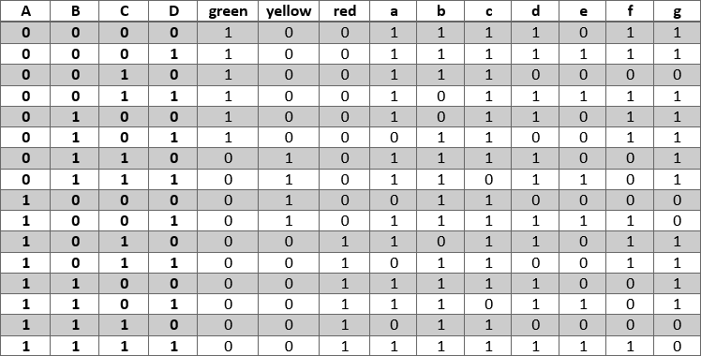
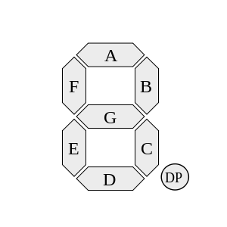
Implementation
Before implementing the circuitry of the system, we must first create the truth table of the desired outputs

Slide 8
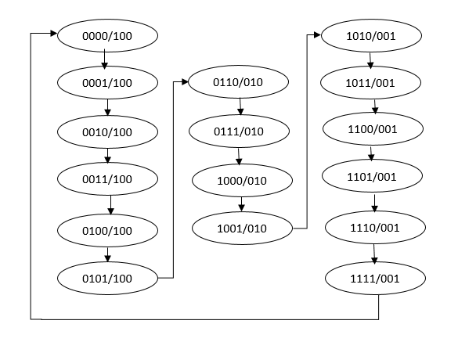
And then represent the desired state transition using a diagram
State transition diagram for the green, yellow, and red LEDs, respectively

Slide 9
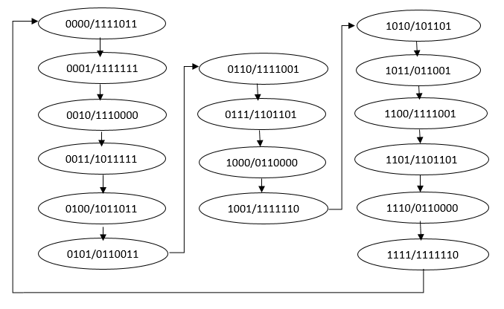
State transition diagram for the counter segments

Slide 10
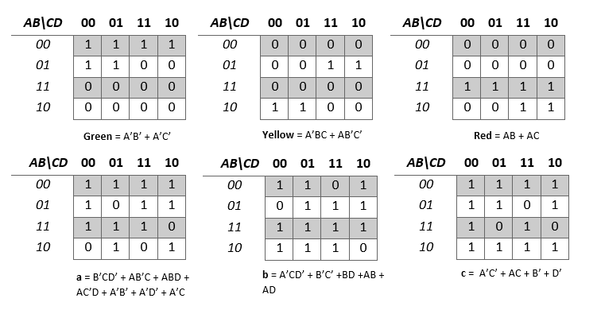
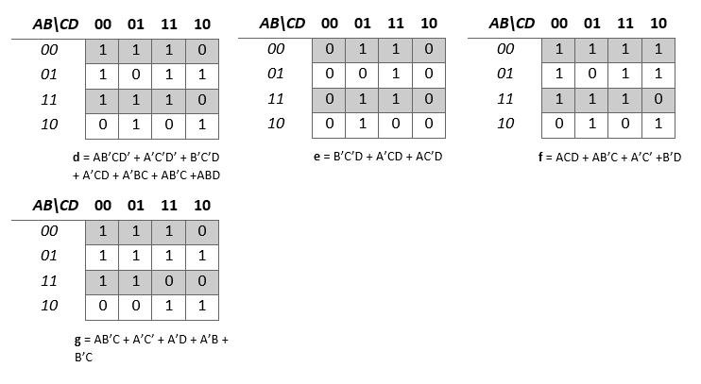
III. Data
Given the minterm list derived from the truth table, our group then generated each output’s simplified forms using Karnaugh Maps.

Slide 11
IV. Data Analysis
Even with the use of Karnaugh maps, the sums of products of each output will still require quite a lot of AND and OR gates. This is where our group applied Boolean algebra in order to further simplify the sums of products in terms of the number of gates being used. The fewer number of gates being used, the better for every system, as it lessens the connections being applied, optimizes its functionality, and removes any redundancy in the process.

Slide 12
Here are the simplified equations for each output:
Green = (A + (BC))’
Yellow = A’BC + (A’ + B + C)’
Red = A(B + C)
a = (B + C’ +D)’ + A(BD + (C + (B + D)’)’) + (A + (BDC’)’)’
b = (A + C’ + D)’ + (B + C)’ + BD + A(B + D)
c = ((A + C) (AC)’ BD)’
d = A((B + C’ + D)’ + B(C’ + D)) + (A + ((C + D)’ + C(D + B)’)’ + (B + C + D’)’
e = D((C + (B’ + A)’)’ + A’C)
f = AB’C + (A + (C’ + D + B)’)’ + BC’

Slide 13
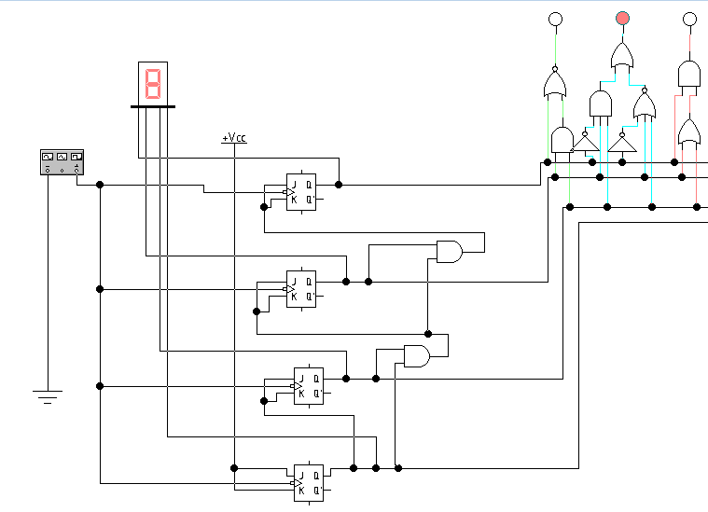
Provided the data gathered, our group was able to implement the components needed into a system.
4 bit output generator
4 bit input 7 segment display
Stoplight circuitry

Slide 14
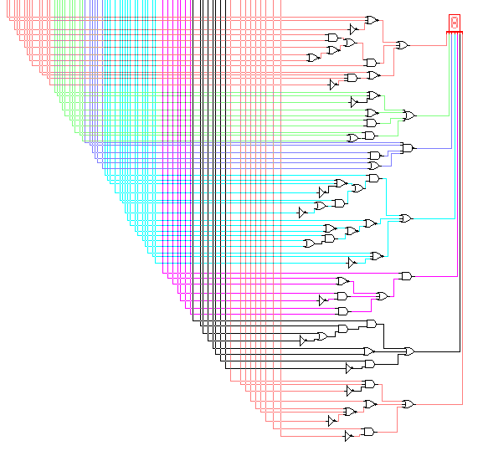
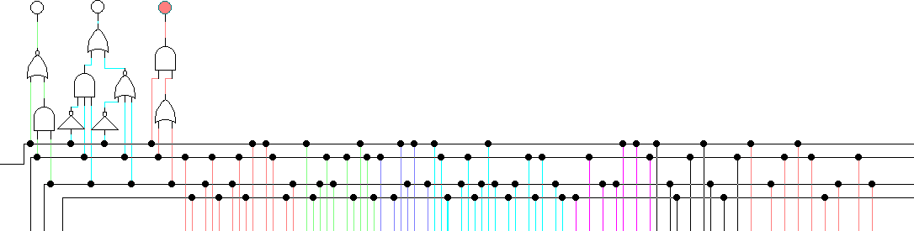
7 input 7 segment display circuitry
Connections to the 4 bit output generator

Slide 15
V. Recommendations
This project, all in all, is already simple. It uses the very basics of binary logic and manipulation, boolean algebra, as well as circuitry. The only way for those who wish to implement the same or a similar system and make it even simpler is by using programmable components such as Arduino or microcontrollers. Depite the price, it optimizes the entire system, leaving you with more space for improvement, modifications, and functionality for your entire system.

Slide 16
VI. Conclusion
The project we chose to implement presents the very foundation of digital systems and logic design. Nothing overly complicated was implemented, and the functionality of the entire system itself is easy to understand. It uses basic components, and applies boolean and binary logic taught in this course to produce the desired output. With further study and research, as well as the application of a larger variety of circuits and components, we may be able to create more complex systems.
The application of digital systems are never ending; from displays, to traffic control, from sensors, to medical equipment, circuitry has been an important factor for the advancement of technology, and most importantly in our everyday lives.

